Slide 1
Future of Microprocessors
Prof. Virender Kumar Ranga

Slide 2
Outline
A 30 year history of microprocessors
  Four generation of innovation
High performance microprocessor drivers:
  Memory hierarchies
  instruction level parallelism (ILP)
Where are we and where are we going?
Focus on desktop/server microprocessors vs. embedded/DSP microprocessor

Slide 3
Microprocessor Generations
First generation: 1971-78
  Behind the power curve
  (16-bit, <50k transistors)
Second Generation: 1979-85
  Becoming “real” computers
  (32-bit , >50k transistors)
Third Generation: 1985-89
  Challenging the “establishment”
  (Reduced Instruction Set Computer/RISC,
  >100k transistors)
Fourth Generation: 1990-
  Architectural and performance leadership
  (64-bit, > 1M transistors,
  Intel/AMD translate into RISC internally)

Slide 4
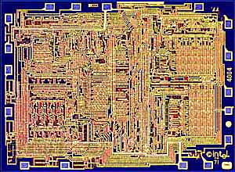
In the beginning (8-bit) Intel 4004
First general-purpose, single-chip microprocessor
Shipped in 1971
8-bit architecture, 4-bit implementation
2,300 transistors
Performance < 0.1 MIPS
(Million Instructions Per Sec)
8008: 8-bit implementation in 1972
  3,500 transistors
  First microprocessor-based computer (Micral)
    Targeted at laboratory instrumentation
    Mostly sold in Europe

Slide 5
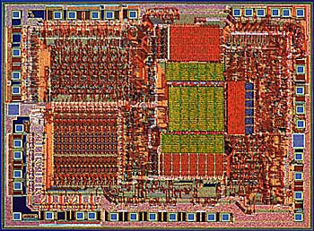
1st Generation (16-bit) Intel 8086
Introduced in 1978
  Performance < 0.5 MIPS
New 16-bit architecture
  “Assembly language” compatible with 8080
  29,000 transistors
  Includes memory protection, support for Floating Point coprocessor
In 1981, IBM introduces PC
  Based on 8088--8-bit bus version of 8086

Slide 6
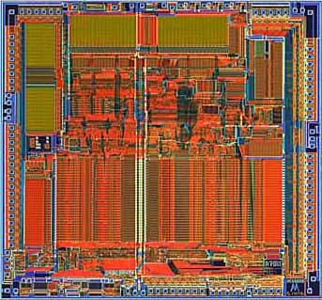
2nd Generation (32-bit) Motorola 68000
Major architectural step in microprocessors:
  First 32-bit architecture
    initial 16-bit implementation
  First flat 32-bit address
    Support for paging
  General-purpose register architecture
    Loosely based on PDP-11 minicomputer
First implementation in 1979
  68,000 transistors
  < 1 MIPS (Million Instructions Per Second)
Used in
  Apple Mac
  Sun , Silicon Graphics, & Apollo workstations

Slide 7
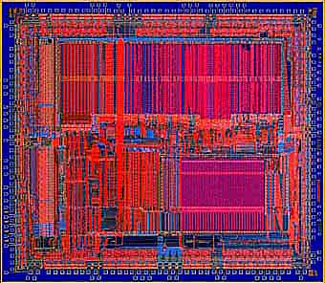
3rd Generation: MIPS R2000
Several firsts:
  First (commercial) RISC microprocessor
  First microprocessor to provide integrated support for instruction & data cache
  First pipelined microprocessor (sustains 1 instruction/clock)
Implemented in 1985
  125,000 transistors
  5-8 MIPS (Million Instructions per Second)

Slide 8
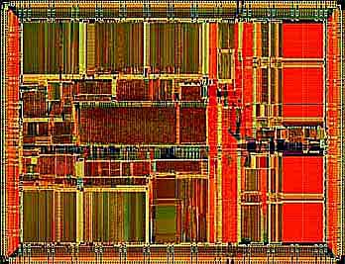
4th Generation (64 bit) MIPS R4000
First 64-bit architecture
Integrated caches
  On-chip
  Support for off-chip, secondary cache
Integrated floating point
Implemented in 1991:
  Deep pipeline
  1.4M transistors
  Initially 100MHz
  > 50 MIPS
Intel translates 80x86/ Pentium X instructions into RISC internally

Slide 9
Key Architectural Trends
Increase performance at 1.6x per year (2X/1.5yr)
  True from 1985-present
Combination of technology and architectural enhancements
  Technology provides faster transistors
  (∝ 1/lithographic feature size) and more of them
  Faster transistors leads to high clock rates
  More transistors (“Moore’s Law”):
    Architectural ideas turn transistors into performance
      Responsible for about half the yearly performance growth
Two key architectural directions
  Sophisticated memory hierarchies
  Exploiting instruction level parallelism

Slide 10
Memory Hierarchies
Caches: hide latency of DRAM and increase BW
  CPU-DRAM access gap has grown by a factor of 30-50!
Trend 1: Increasingly large caches
  On-chip: from 128 bytes (1984) to 100,000+ bytes
  Multilevel caches: add another level of caching
    First multilevel cache:1986
    Secondary cache sizes today: 128,000 B to 16,000,000 B
    Third level caches: 1998
Trend 2: Advances in caching techniques:
  Reduce or hide cache miss latencies
    early restart after cache miss (1992)
    nonblocking caches: continue during a cache miss (1994)
  Cache aware combos: computers, compilers, code writers
    prefetching: instruction to bring data into cache early

Slide 11
Exploiting Instruction Level Parallelism (ILP)
ILP is the implicit parallelism among instructions (programmer not aware)
Exploited by
  Overlapping execution in a pipeline
  Issuing multiple instruction per clock
    superscalar: uses dynamic issue decision (HW driven)
    VLIW: uses static issue decision (SW driven)
1985: simple microprocessor pipeline (1 instr/clock)
1990: first static multiple issue microprocessors
1995: sophisticated dynamic schemes
  determine parallelism dynamically
  execute instructions out-of-order
  speculative execution depending on branch prediction
“Off-the-shelf” ILP techniques yielded 15 year path of 2X performance every 1.5 years => 1000X faster!

Slide 12
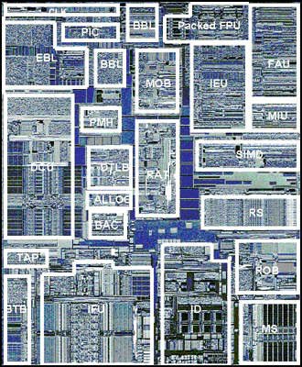
Where have all the transistors gone?
Superscalar
(multiple instructions per clock cycle)
Execution
2 Bus Intf
3 levels of cache
D
cache
TLB
Branch prediction
(predict outcome of decisions)
Out-Of-Order
branch
Out-of-order execution (executing instructions in different order than programmer wrote them)
SS
Icache
Intel Pentium III
(10M transistors)

Slide 13
Deminishing Return On Investment
Until recently:
  Microprocessor effective work per clock cycle (instructions per clock)goes up by ~ square root of number of transistors
  Microprocessor clock rate goes up as lithographic feature size shrinks
With >4 instructions per clock, microprocessor performance increases even less efficiently
Chip-wide wires no longer scale with technology
  They get relatively slower than gates ∝ (1/scale)³
  More complicated processors have longer wires

Slide 14
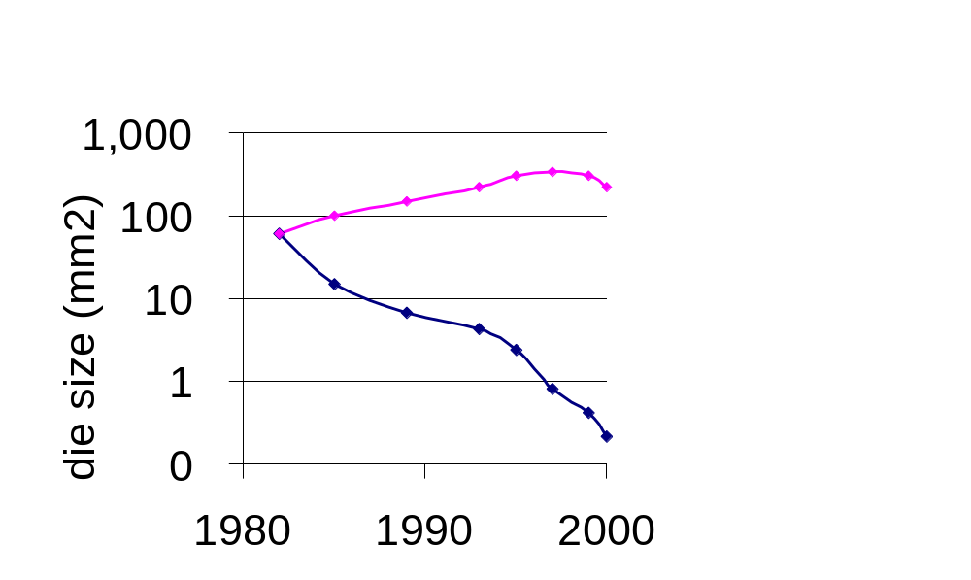
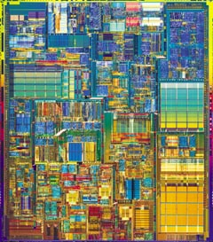
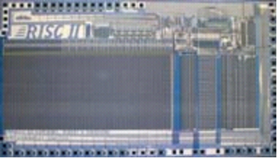


Moore’s Law vs. Common Sense?
Intel MPU die
~1000X
RISC II die
Scaled 32-bit, 5-stage RISC II 1/1000th of current MPU, die size or transistors (1/4 mm² )

Slide 15
New view: ClusterOnaChip (CoC)
Use several simple processors on a single chip:
  Performance goes up linearly in number of transistors
  Simpler processors can run at faster clocks
  Less design cost/time, Less time to market risk (reuse)
Inspiration: Google
  Search engine for world: 100M/day
  Economical, scalable build block:
  PC cluster today 8000 PCs, 16000 disks
  Advantages in fault tolerance, scalability, cost/performance
32-bit MPU as the new “Transistor”
  “Cluster on a chip” with 1000s of processors enable amazing MIPS/$, MIPS/watt for cluster applications
  MPUs combined with dense memory + system on a chip CAD
30 years ago Intel 4004 used 2300 transistors:
when 2300 32-bit RISC processors on a single chip?

Slide 16
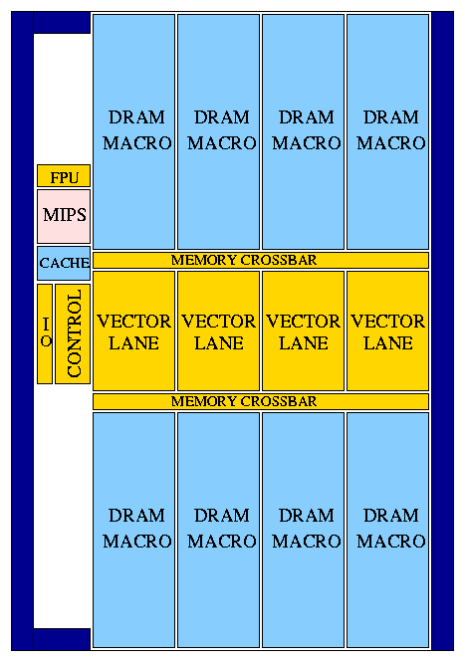
VIRAM-1 Integrated Processor/Memory
15 mm
Microprocessor
  256-bit media processor (vector)
  14 MBytes DRAM
  2.5-3.2 billion operations per second
  2W at 170-200 MHz
  Industrial strength compiler
280 mm² die area
  18.72 x 15 mm
  ~200 mm² for memory/logic
  DRAM: ~140 mm²
  Vector lanes: ~50 mm²
Technology: IBM SA-27E
  0.18μm CMOS
  6 metal layers (copper)
Transistor count: >100M
Implemented by 6 Berkeley graduate students
18.7 mm
Thanks to DARPA: funding
IBM: donate masks, fab
Avanti: donate CAD tools
MIPS: donate MIPS core
Cray: Compilers, MIT:FPU
Notes:
This figure presents the floorplan of Vector IRAM. It occupies nearly 300 square mm and 150 million transistors in a 0.18um CMOS process by IBM. Blue blocks on the floorplan indicate DRAM macros or compiled SRAM blocks. Golden blocks are those designed at Berkeley. They included synthesized logic for control and the FP datapaths, and full custom logic for register files, integer datapaths and DRAM.
Vector IRAM operates at 200MHz. The power supply is 1.2V for logic and 1.8V for DRAM. The peak performance for the vector unit is 1.6 giga ops for 64bit integer operations. Performance doubles or quadruples for 32 and 16b operations respectively. Peak floating point performance is 1.6 Gflops.
There are several interesting things to notice on the floorplan. First the overall design modularity and scalability. It mostly consists of replicated DRAM macros and vector lanes connected through a crossbar. Another very interesting feature is the percentage of this design directly visible to software. Compilers can control any part of the design that is registers, datapaths or main memory. They do that by scheduling proper arithmetic or load store instructions. The majority of our design is used for main memory, vector registers and datapaths. On the other hand, if you take a look at a processor like Pentium 3, you will see that less than 20% of its are is used for datapaths and registers. The rest is caches and dynamic issue logic. While this usually work for the benefit of applications, they cannot be controlled by compiler and they cannot be turned off when not necessary.

Slide 17
Concluding Remarks
A great 30 year history and a challenge for the next 30!
  Not a wall in performance growth, but a slowing down
    Diminishing returns on silicon investment
But need to use right metrics.
Not just raw (peak) performance, but:
  Performance per transistor
  Performance per Watt
Possible New Direction?
  Consider true multiprocessing?
  Key question: Could multiprocessors on a single piece of silicon be much easier to use efficiently then today’s multiprocessors?
(Thanks to John Hennessy@Stanford,
Norm Jouppi@Compaq for most of these slides)

